Slide 1

THE DUO CATERINGS a catering service system
Guided by: Prof.Sarika Patil
Presented by: Atharva Kakade
Sanket Muluk

Slide 2
Agenda
Introduction Problem Statement Existing System Architecture Use Case ER Diagram Activity Future Scope Objective Software & Hardware Requirements

Slide 3
Introduction
“The Duo Caterings” is a catering service system that helps you manage your catering business efficiently. A thorough management system for catering services is required, one that can handle order administration, inventory management, and client relationship management. In order to meet the varied needs of catering, this project’s goal is to create a catering service system that is simple to use, adaptable, and user-friendly.

Slide 4
Problem statement
The issue is that current catering service systems frequently have functional limitations and fall short of catering service providers’ needs.
A thorough management system for catering services is required, one that can handle order administration, inventory management, and client relationship management.

Slide 5
Existing System
In the existing system the service is carried out manually which is neither organised nor efficient.
The menu management, order management and inventory management is done manually which can get hectic and can be prone to human errors.

Slide 6
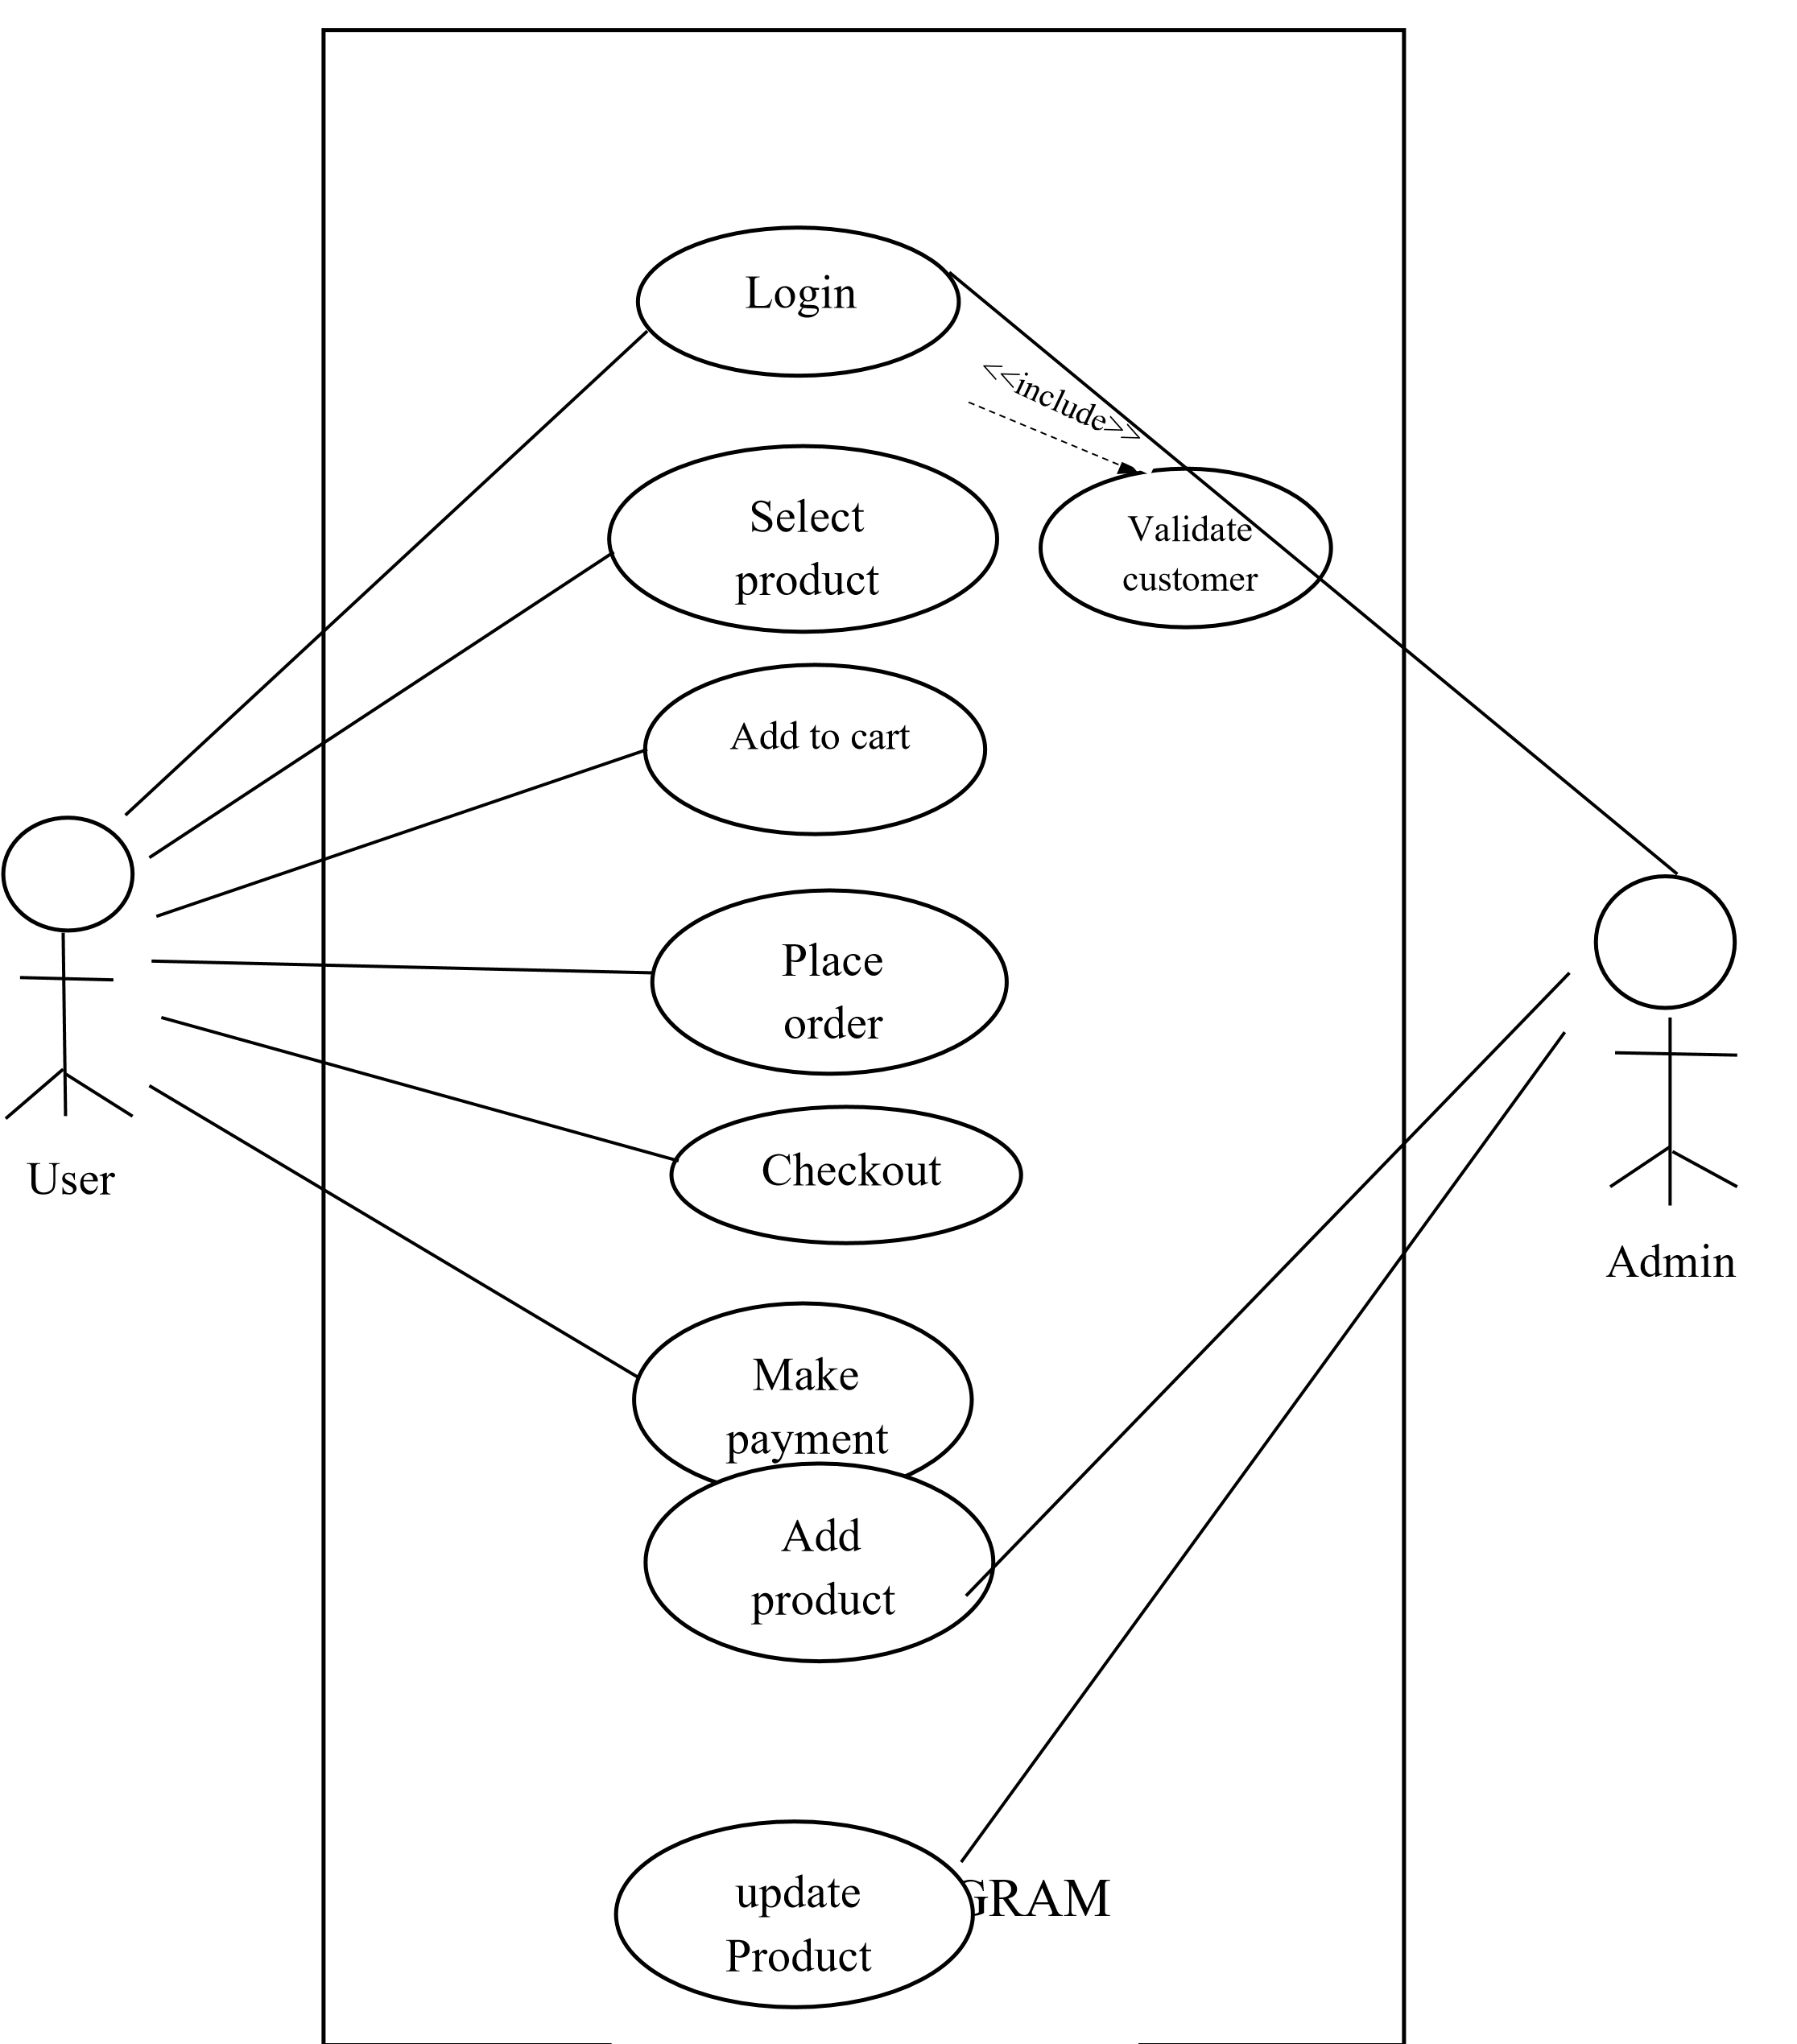
Use case diagram

Slide 7
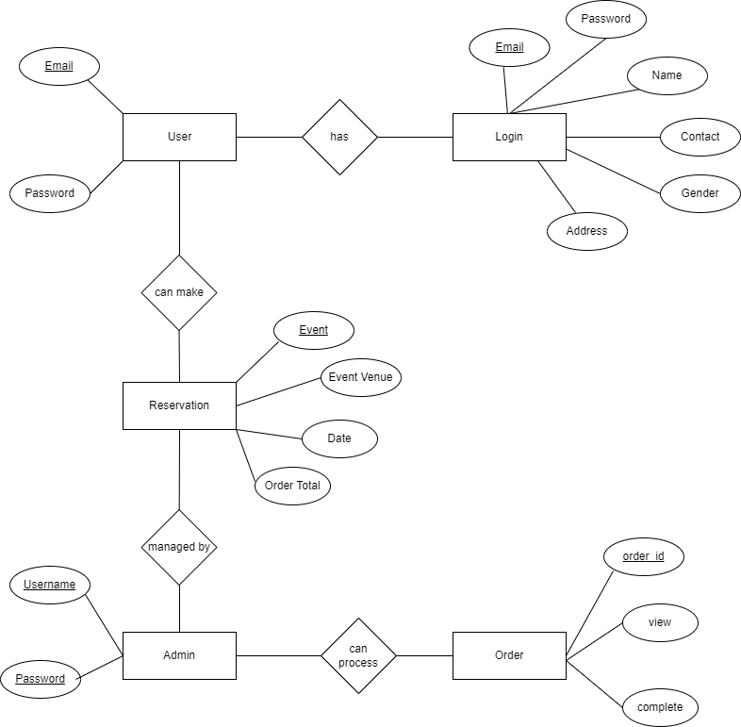
ER diagram

Slide 8
Future Scope
The adoption of a mobile app or online portal for consumers is a future improvement for a catering service system.
Customers would be able to do this from their computers or mobile devices and place orders, check menus and pricing, and monitor their orders in real-time.
Customers might buy catering services more easily with such a system, and it would also improve the company’s presence in the internet market.

Slide 9
Objective
To improve overall efficiency and streamline a catering company’s operations, a management system for catering services is required.
Businesses can use this system to automate a number of processes, including event planning, menu planning, food preparation, inventory management, and order tracking.
Businesses can improve customer satisfaction, lower expenses, and increase efficiency by utilising a catering service system.

Slide 10
Software and hardware requirements
Hardware requirement:
Processor i3 at least
RAM system at least 1 Gb or above
Software requirement:
Front end: HTML, CSS, JavaScript
Back end: PHP, MySQL
Server: Xampp

Slide 11
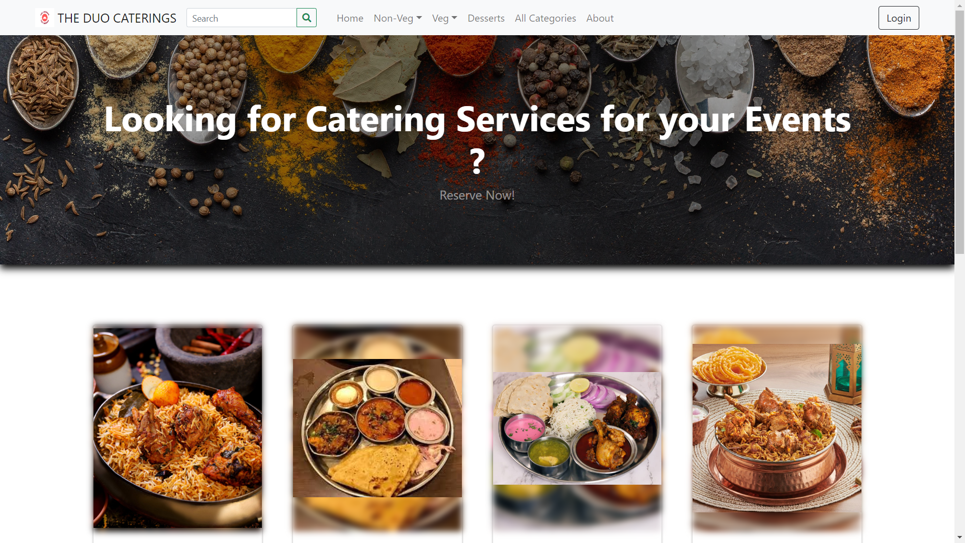
HOME PAGE

Slide 12
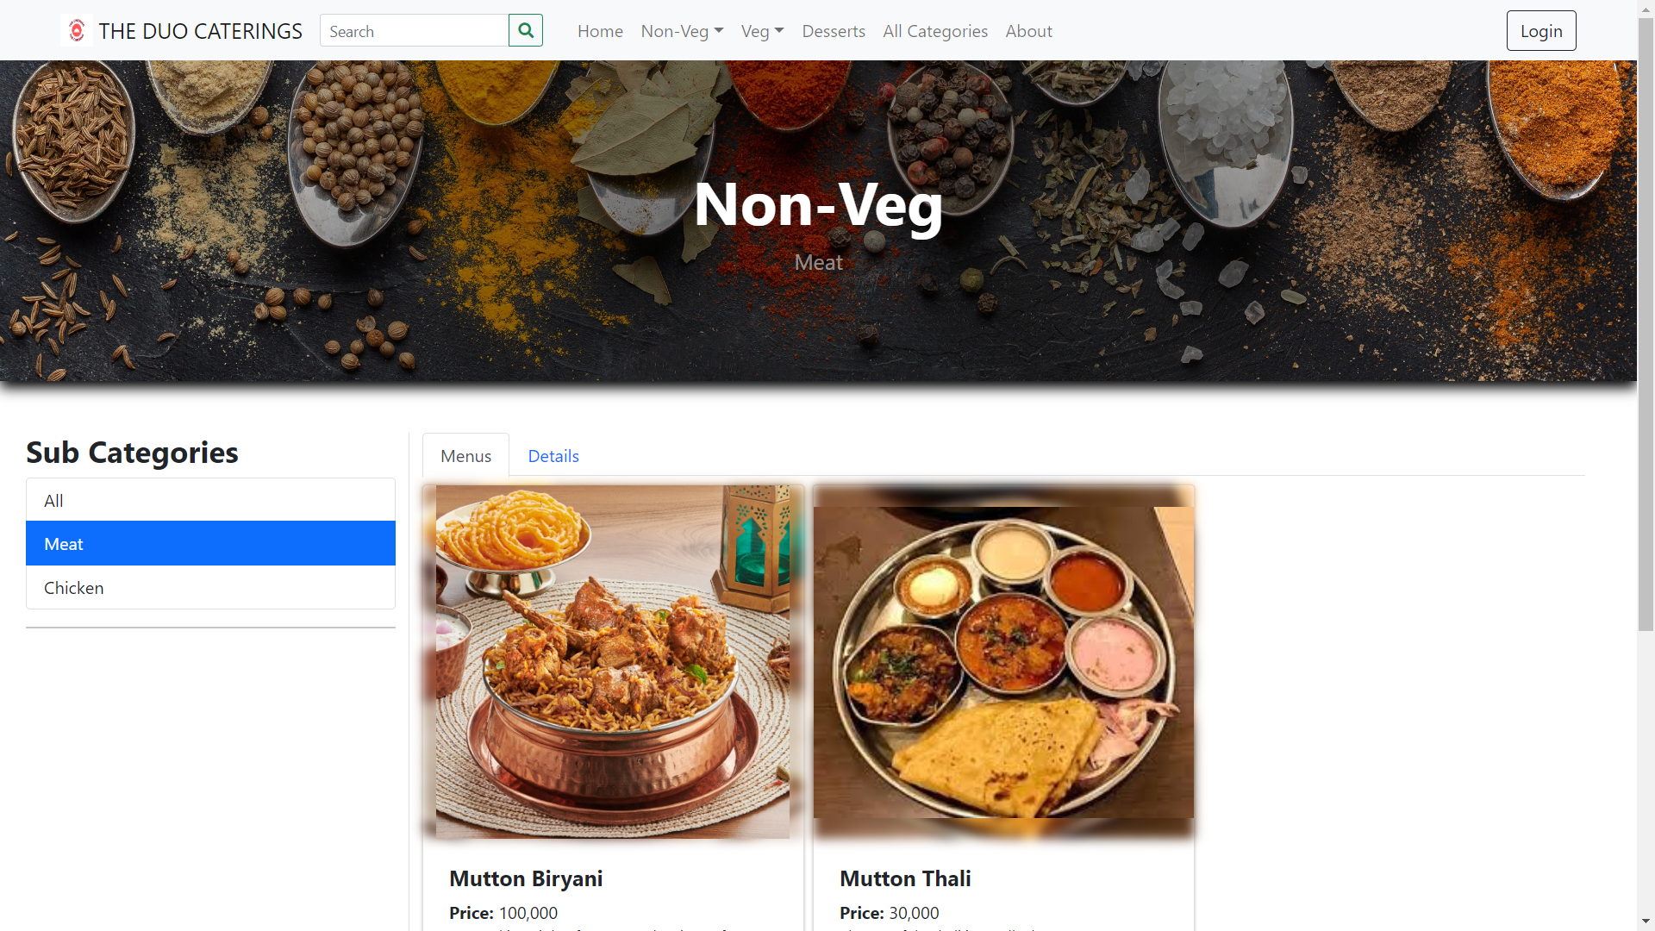
MENU

Slide 13
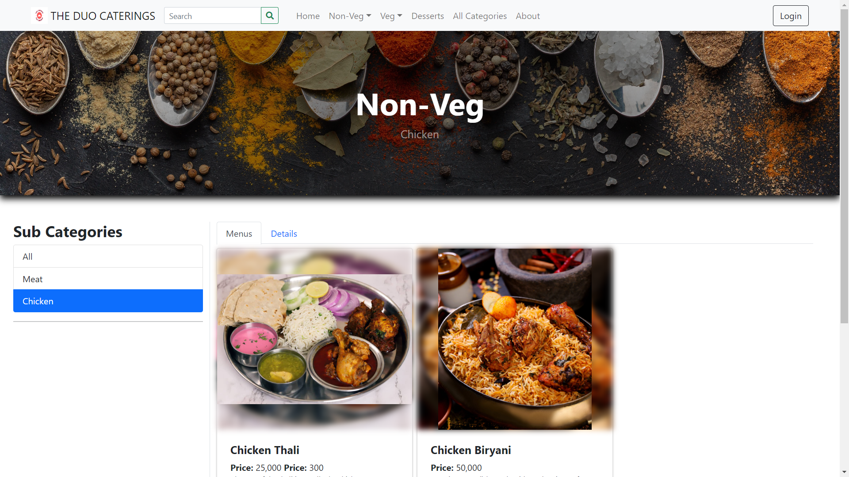

Slide 14
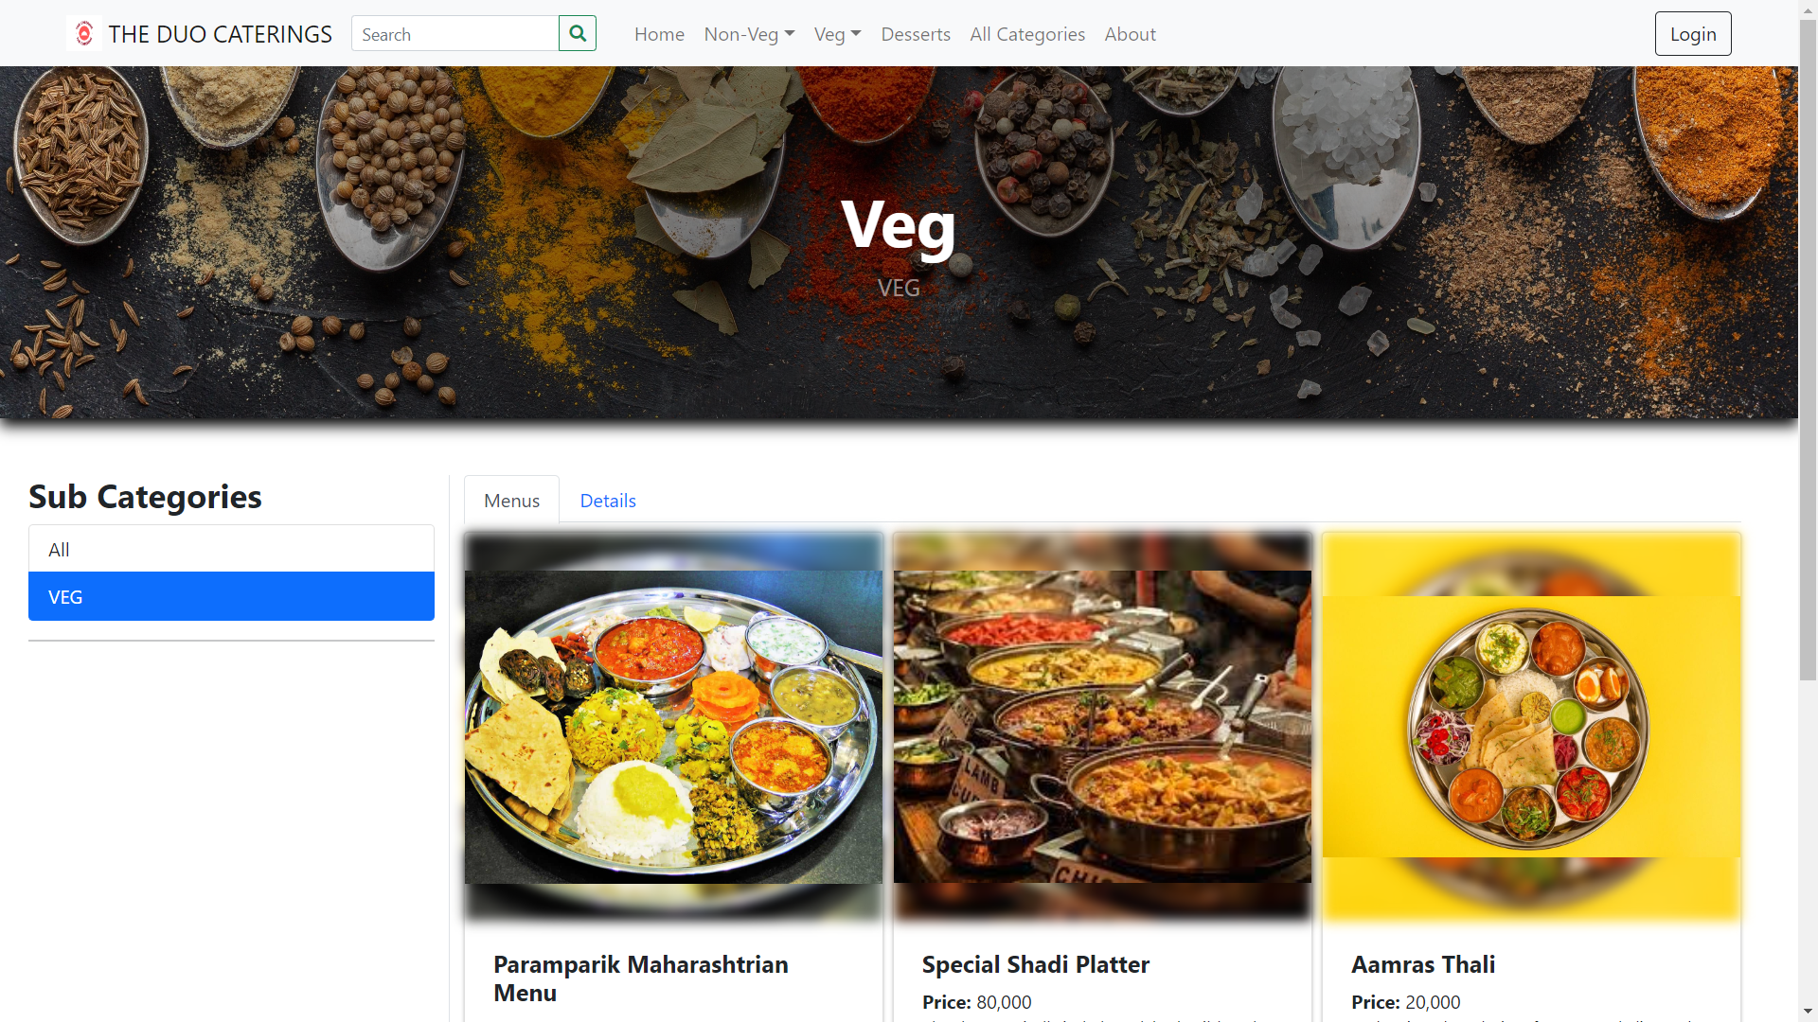

Slide 15
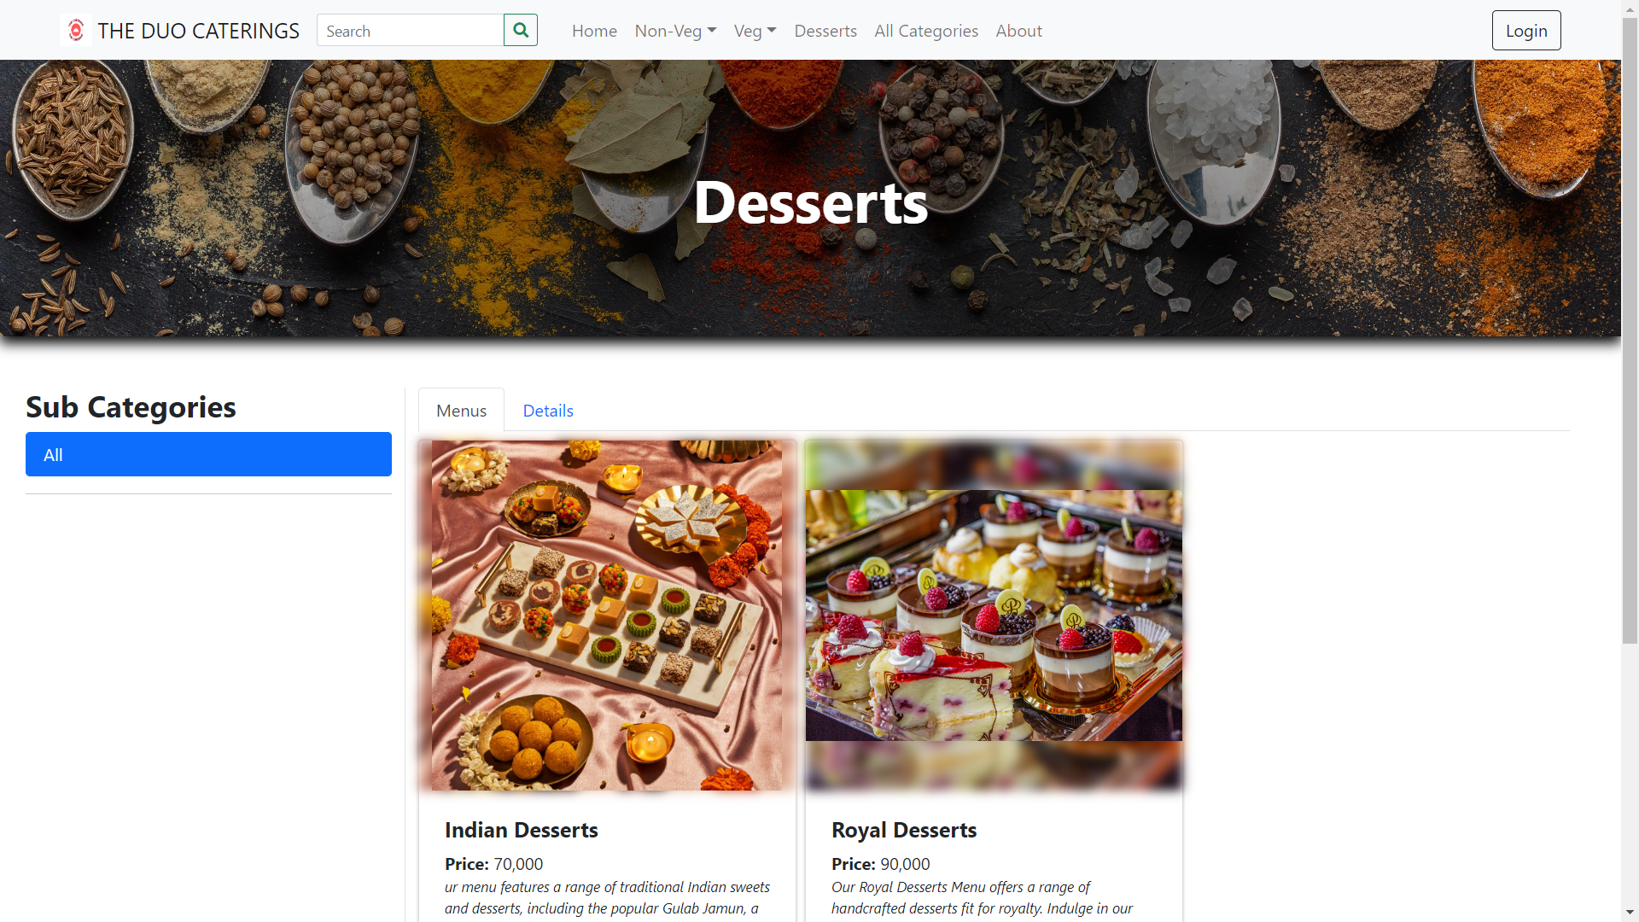

Slide 16
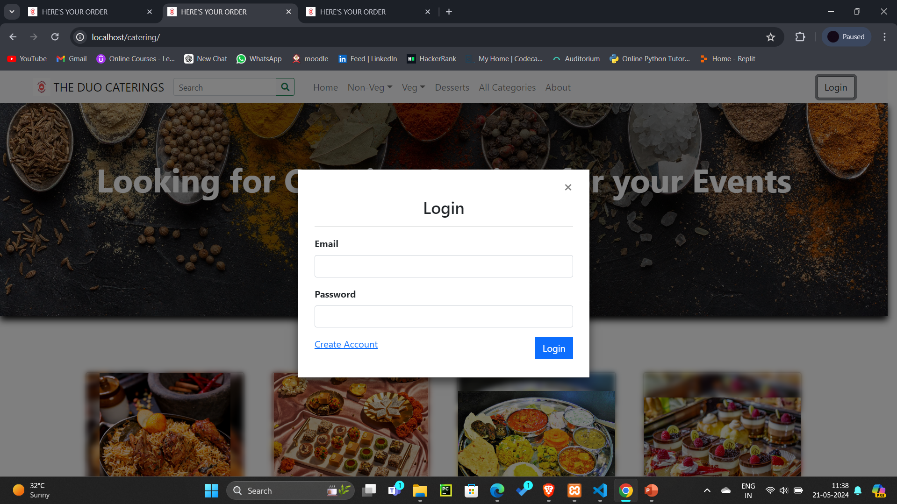
USER LOGIN

Slide 17
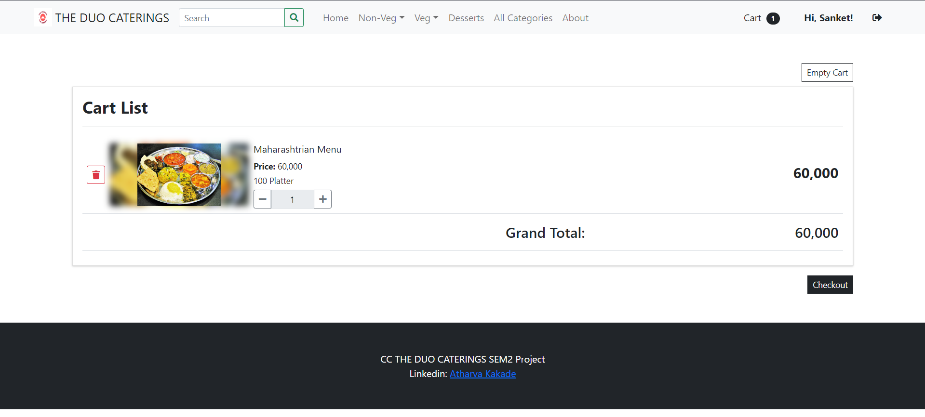
CART

Slide 18
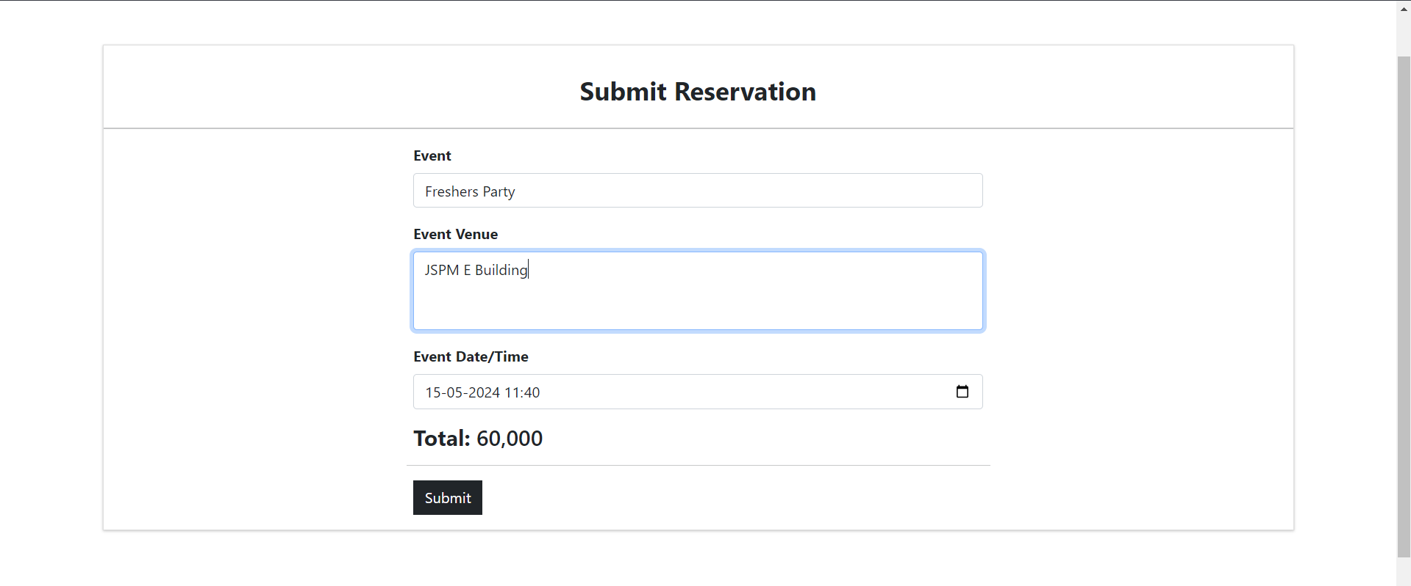
RESERVATIONS

Slide 19
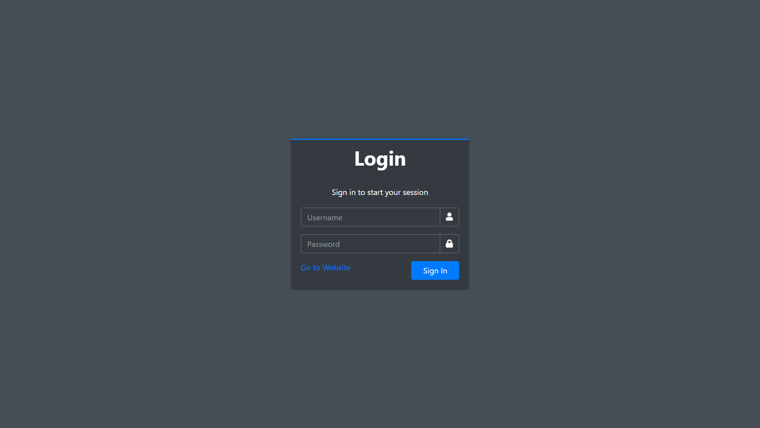
ADMIN LOGIN

Slide 20
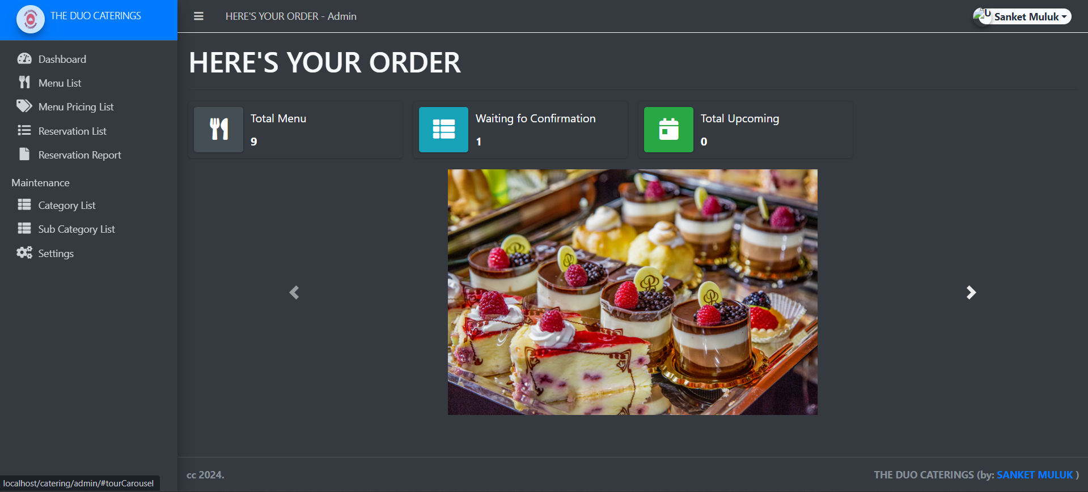
DASHBOARD

Slide 21
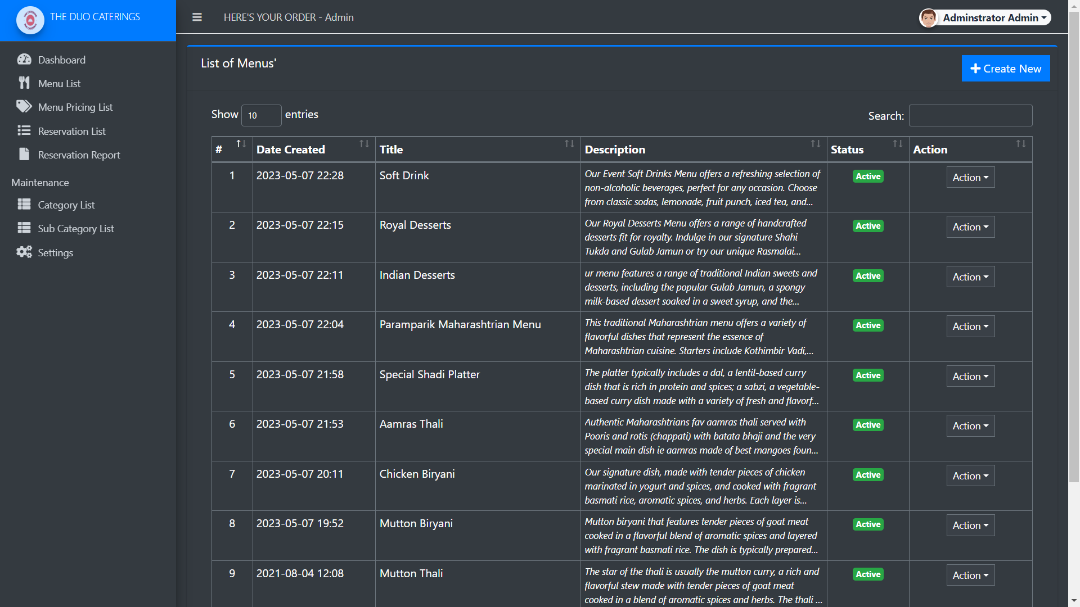
MENU

Slide 22
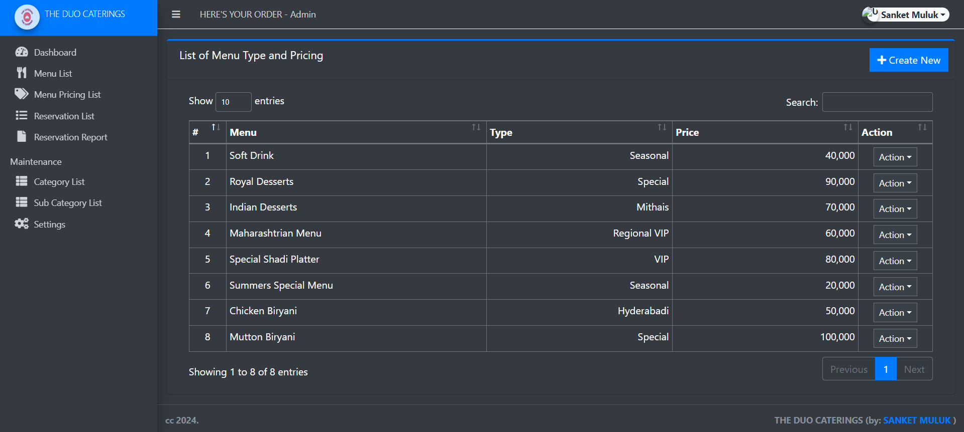
MENU PRICING

Slide 23
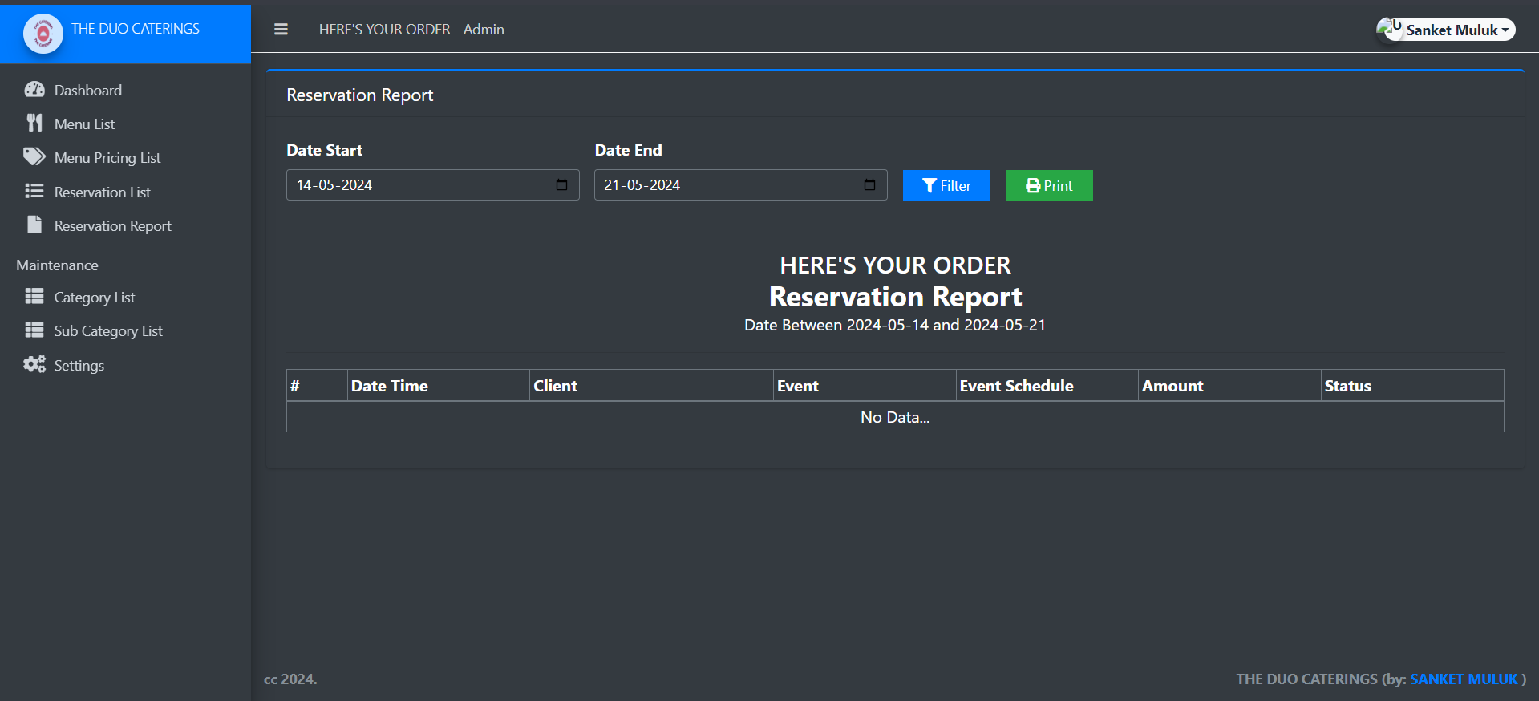
RESERVATION MANAGEMENT

Slide 24


